Slide 1
CloudFrontiers
Sarvesh Sundaram, Hayden Diver, Chris Sandoval

Slide 2



Our Team
Sarvesh Sundaram
Front-End Developer
Focus: HTML/CSS/JavaScript
Chris Sandoval
Back-End Developer
Focus: JavaScript/JQuery
Hayden Diver
Back-End Developer
Focus: JavaScript/JQuery
Notes:
Everyone

Slide 3
Agenda
01
02
03
04
05
Project Overview
& Mockup
Focus Areas
& Implementation
Demo
Challenges We Faces
Future Steps
Notes:
Chris

Slide 4
01
Project Overview
& Mockup
Notes:
Chris

Slide 5


What is the Problem?
Sandra Richardson
James Shakman
Developer for AMD
Tasked with making Market Analysis on best Products to host websites
Has never done market analysis and doesn’t know where to start
Product Owner at NYTimes
Needs to Research Best NoSQL Databases as part of NYTimes’ initiative to move from on-site servers to the cloud
Has 3-day deadline
Notes:
Chris

Slide 6
The Common Problem
They both need help making their Market Analysis!
What do they do?
Notes:
Chris

Slide 7
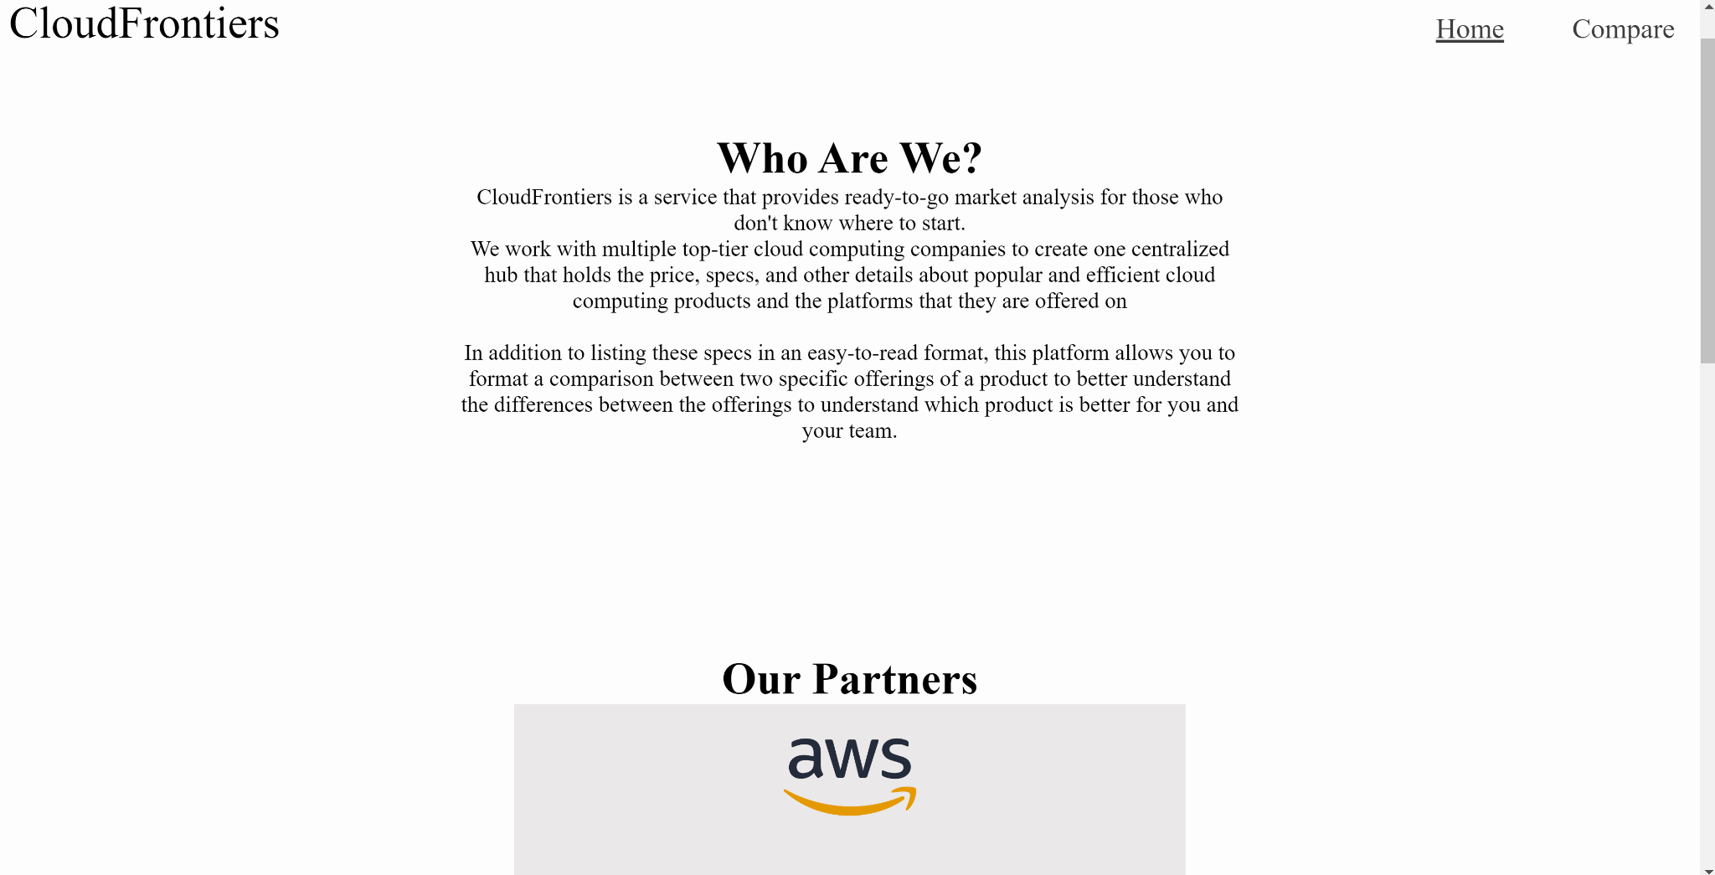
Introducing CloudFrontiers
CloudFrontiers is a service that provides ready-to-go market analysis of Cloud-Native Product for those who don't know where to start
Centralized hub that has displays specs on popular and efficient cloud computing products
Website Homepage
Notes:
Chris

Slide 8
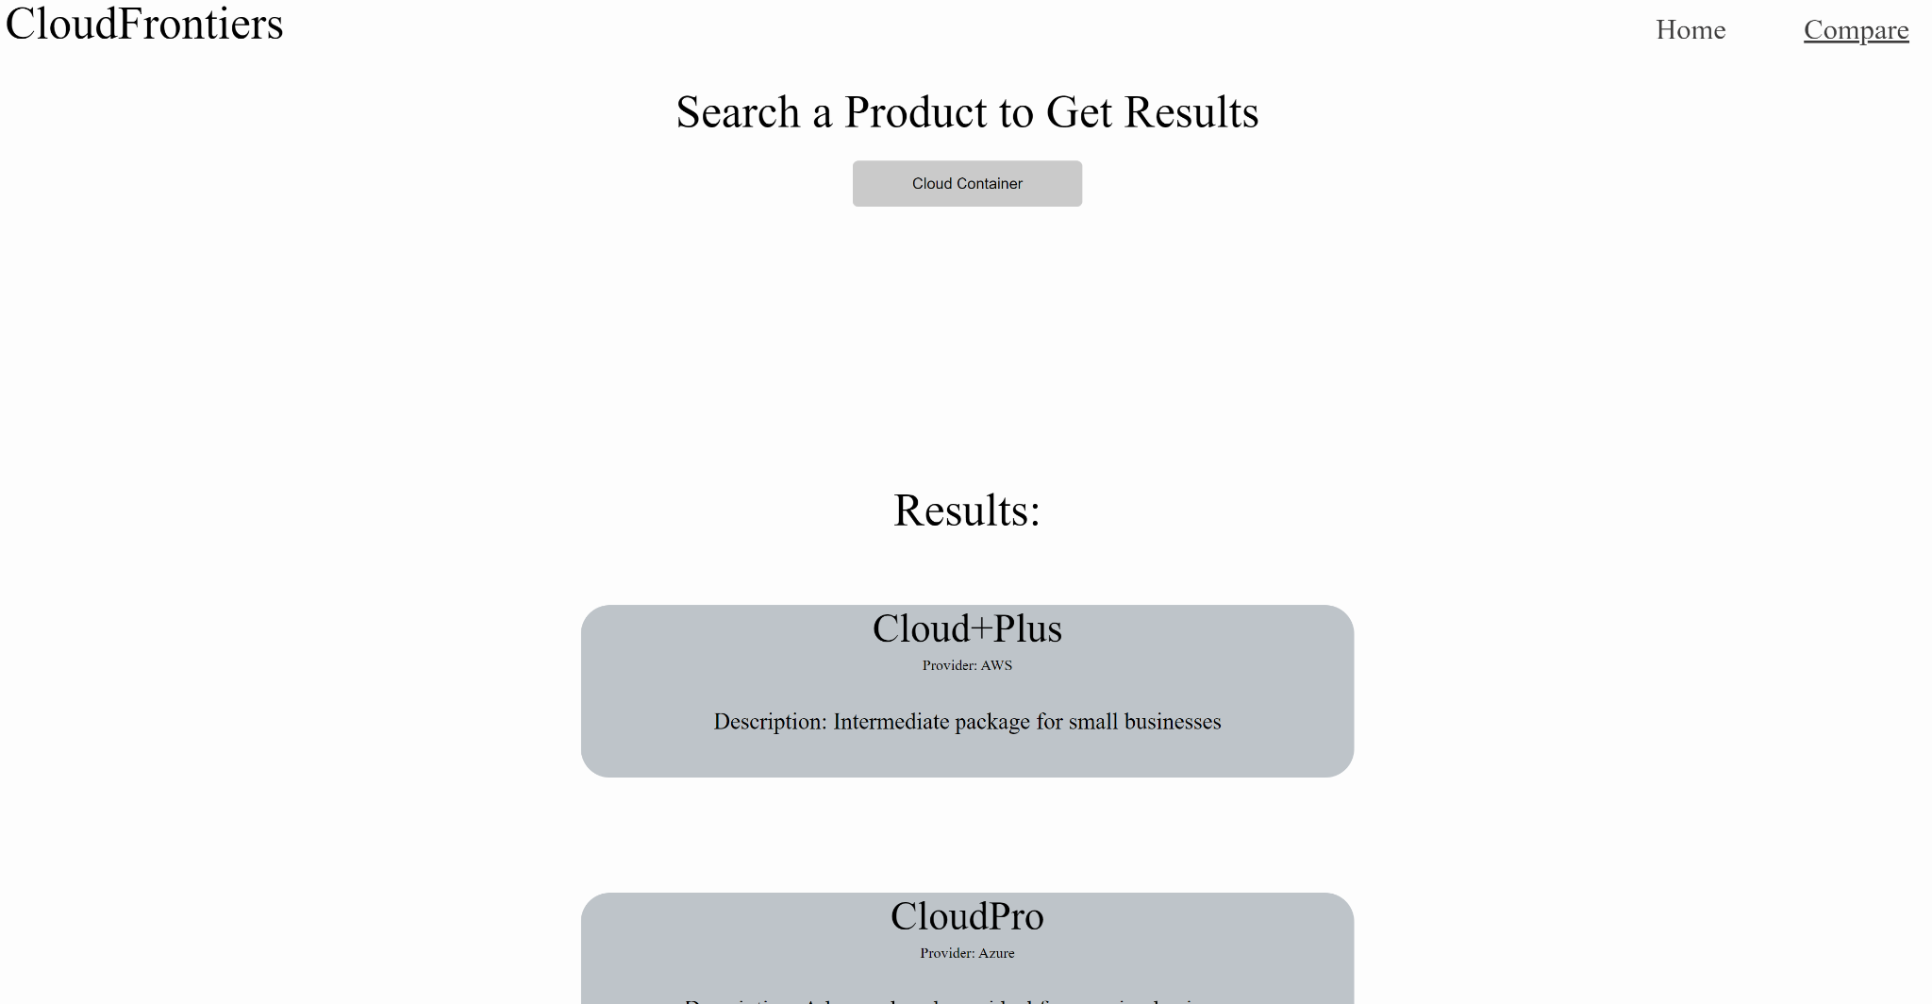
So, For Example…
John and Sandra can search for the best offerings of NoSQL Databases or Cloud Containers, with results displayed in an easy-to-read format and can export the data
They can use this as either a launching point for further research or as their primary analysis
Notes:
Hayden

Slide 9
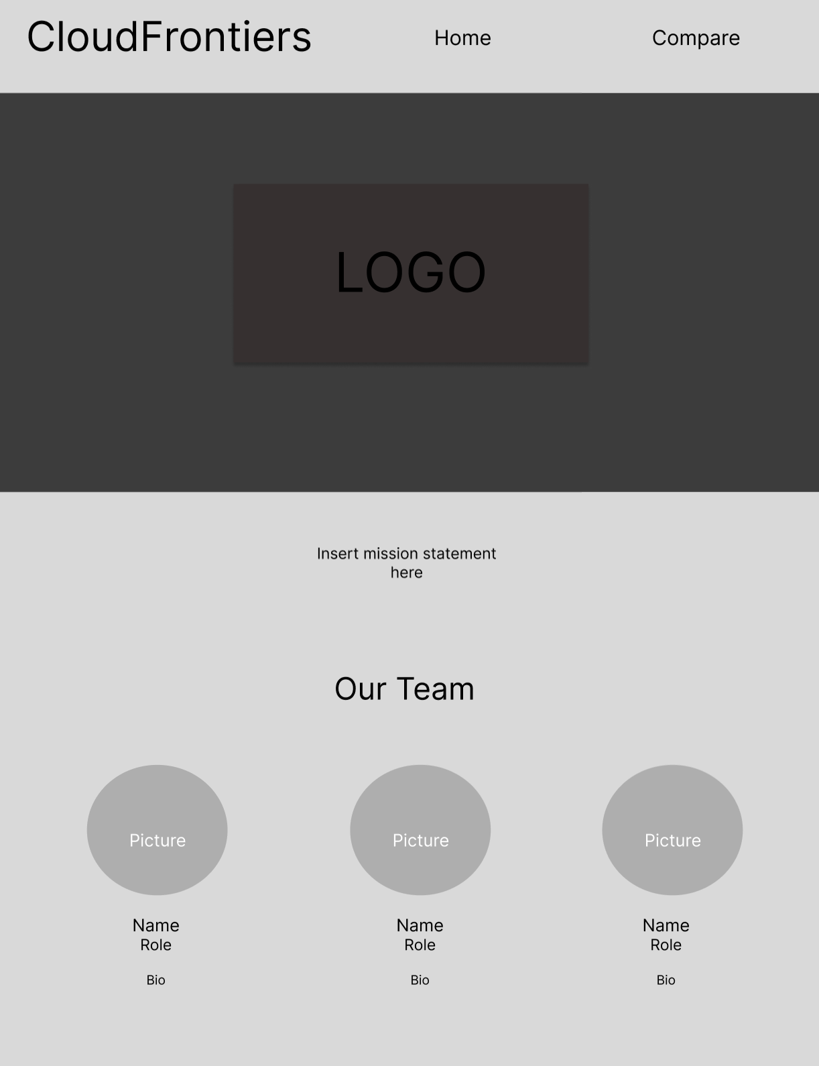
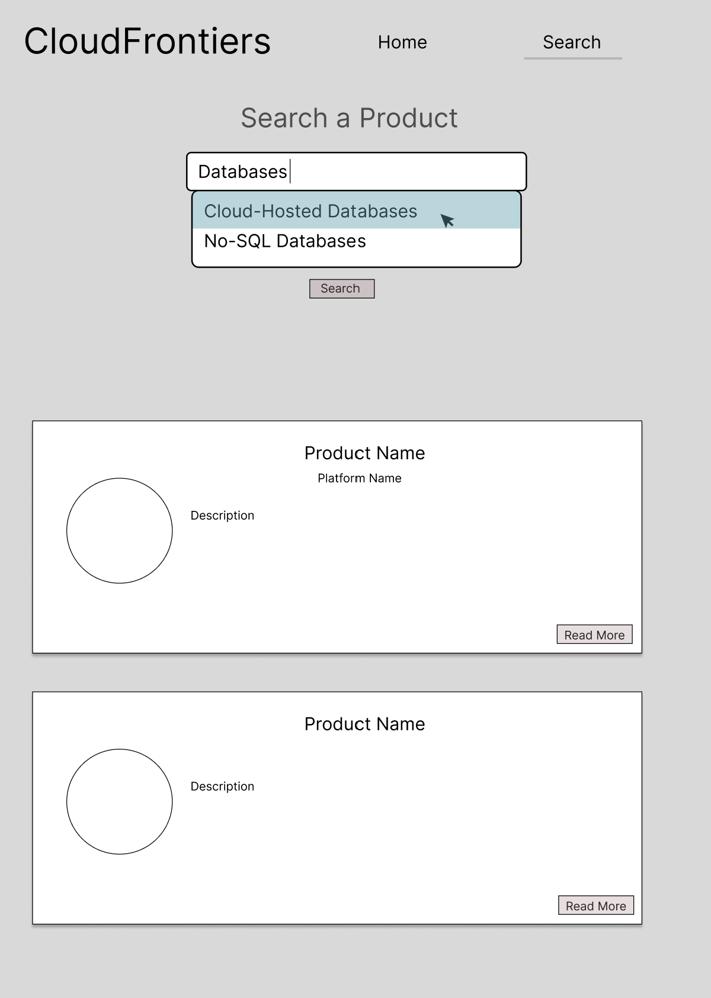
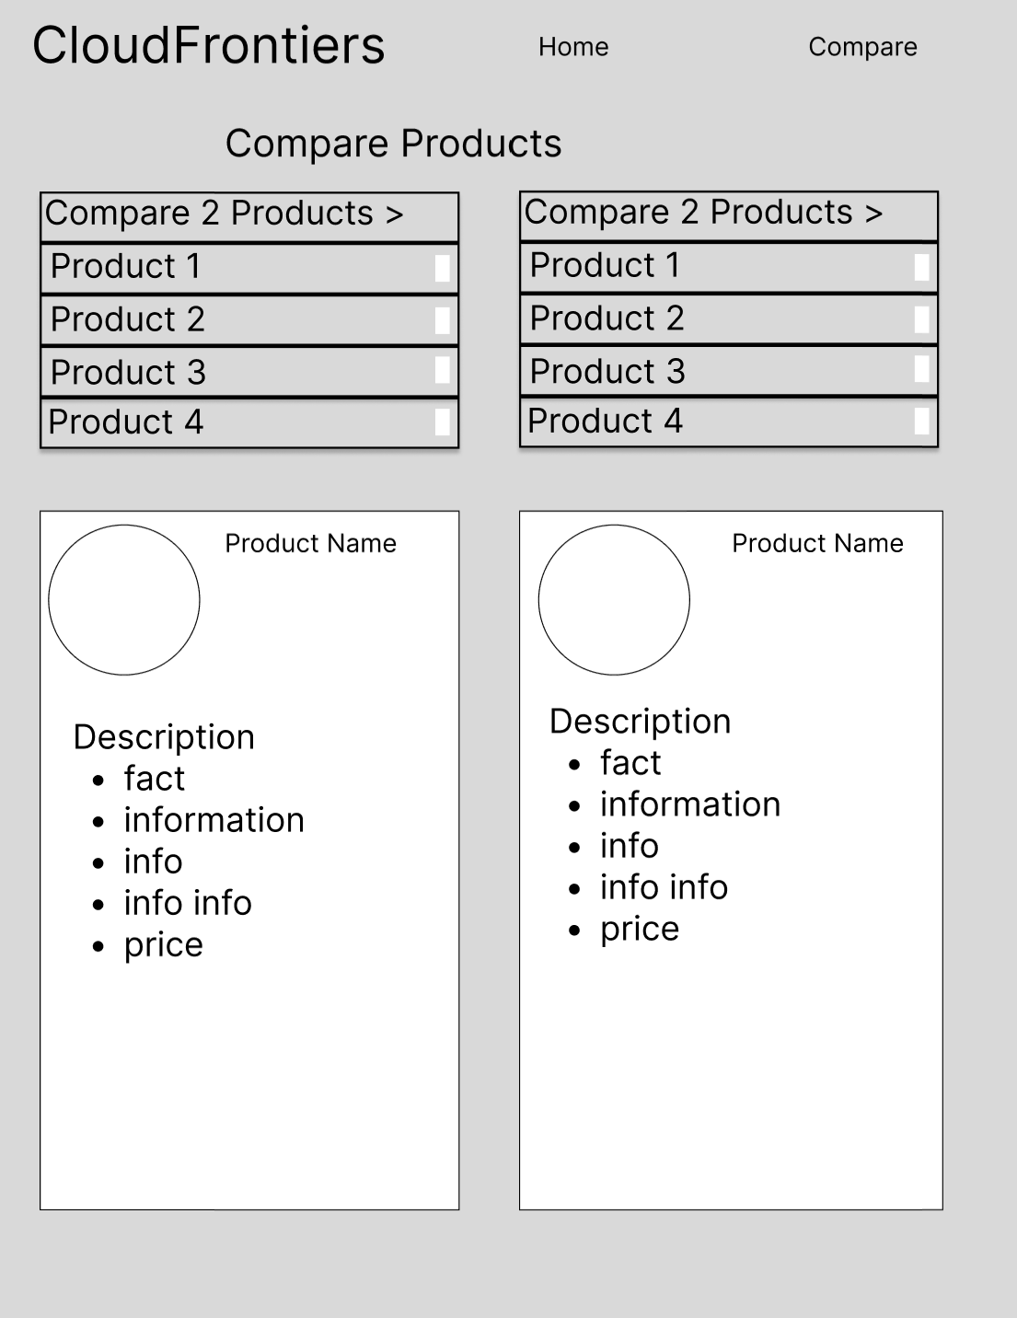
The Mockup
Homepage
Comparison 1
Comparison 2
The Homepage offers key information about our website's purpose and the benefits of using our service.
The Comparison Page 1 lists the all available products under a label (NOSQL DB, Container, etc.)
The Comparison Page 2 allows users to compare the features of two specific cloud products
Notes:
Hayden

Slide 10
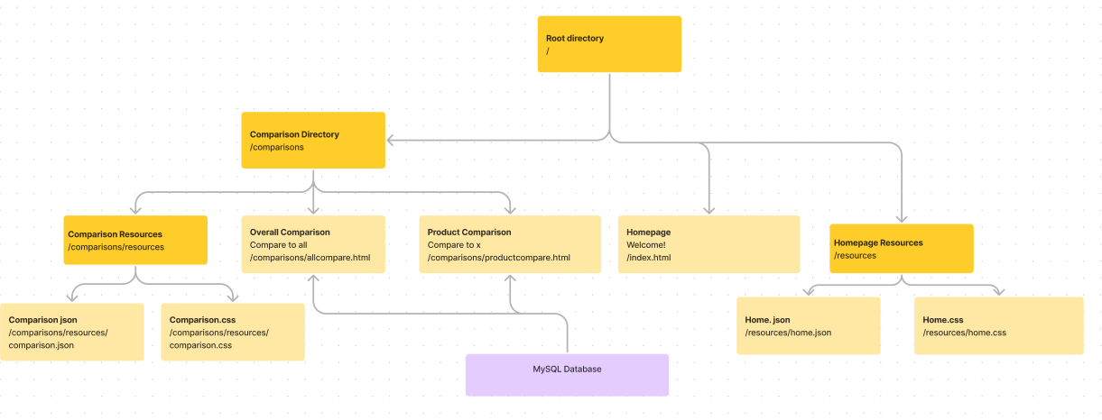
Our Architecture
More Sequential Approach, similar to google forms (page1 -> page2 -> etc.)
Format: HomePage -> ComparisonPage1 -> ComparisonPage2
Later added export data page, accessed from ComparisonPage2
Original Architecture Layout
Notes:
Hayden

Slide 11
02
Focus Areas & Implementation

Slide 12
Our Focus Areas
Main
Secondary
JavaScript/JQuery
Pulling from JSON
Used Primarily in Comparison Page 1
JSON is read in and relevant rows are displayed
Put in cache & used in other pages
Animations on data
Parsing JSON data & loading
User Interaction
Data Exporting
Notes:
Sarvesh

Slide 13
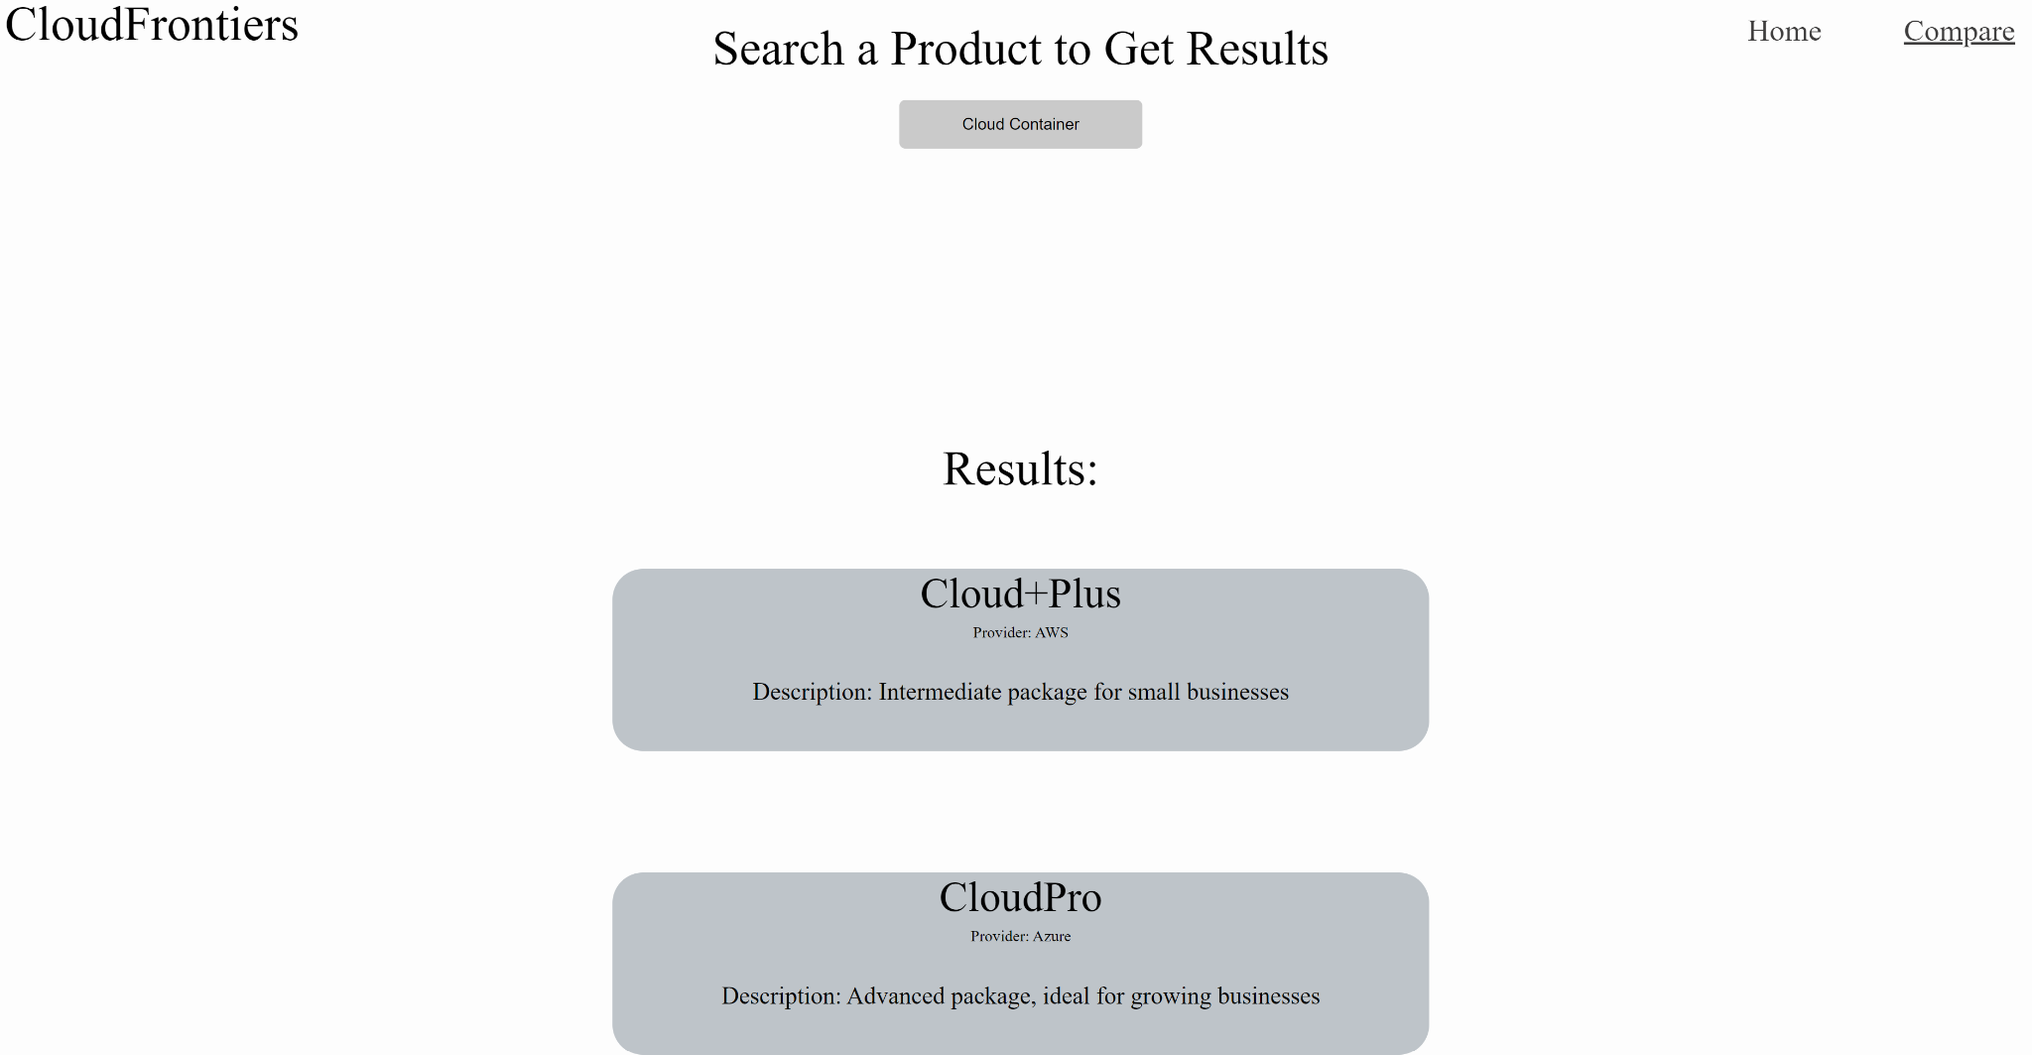
Implementation Example
JSON
In the Back-End, a JSON File was read with data on each product when the person selected dropdown
JavaScript
JS was used to provide events to load data when person selects the dropdown
JavaScript
JS was to actually parse the JSON data and load them onto the page
Notes:
Sarvesh

Slide 14
03
Demo
Notes:
Sarvesh

Slide 15
04
Challenges Faced
Notes:
Hayden

Slide 16
Challenges
Incorporating PHP to retrieve information from the database
01
Juggling the use of HTML alongside our primary focus on JavaScript
02

Slide 17
05
Future Steps
Notes:
Chris

Slide 18
Implementations to Consider
Replace here
Using a SQL database
Text input implementation
Web scraping for data
Notes:
Chris

Slide 19
Thanks!
Do you have any questions?

